Slide 1
Scenario
Jane is a client-facing employee and is responsible for responding to inquiries to your unit’s general email account. Your office expectation is that every reasonable email question or request is timely and courteously responded to. You’ve noticed a pattern where Jane is taking exceedingly long to respond to emails and is often curt in her responses to certain types of inquiries.
- break into groups of two and give this feedback

Slide 2
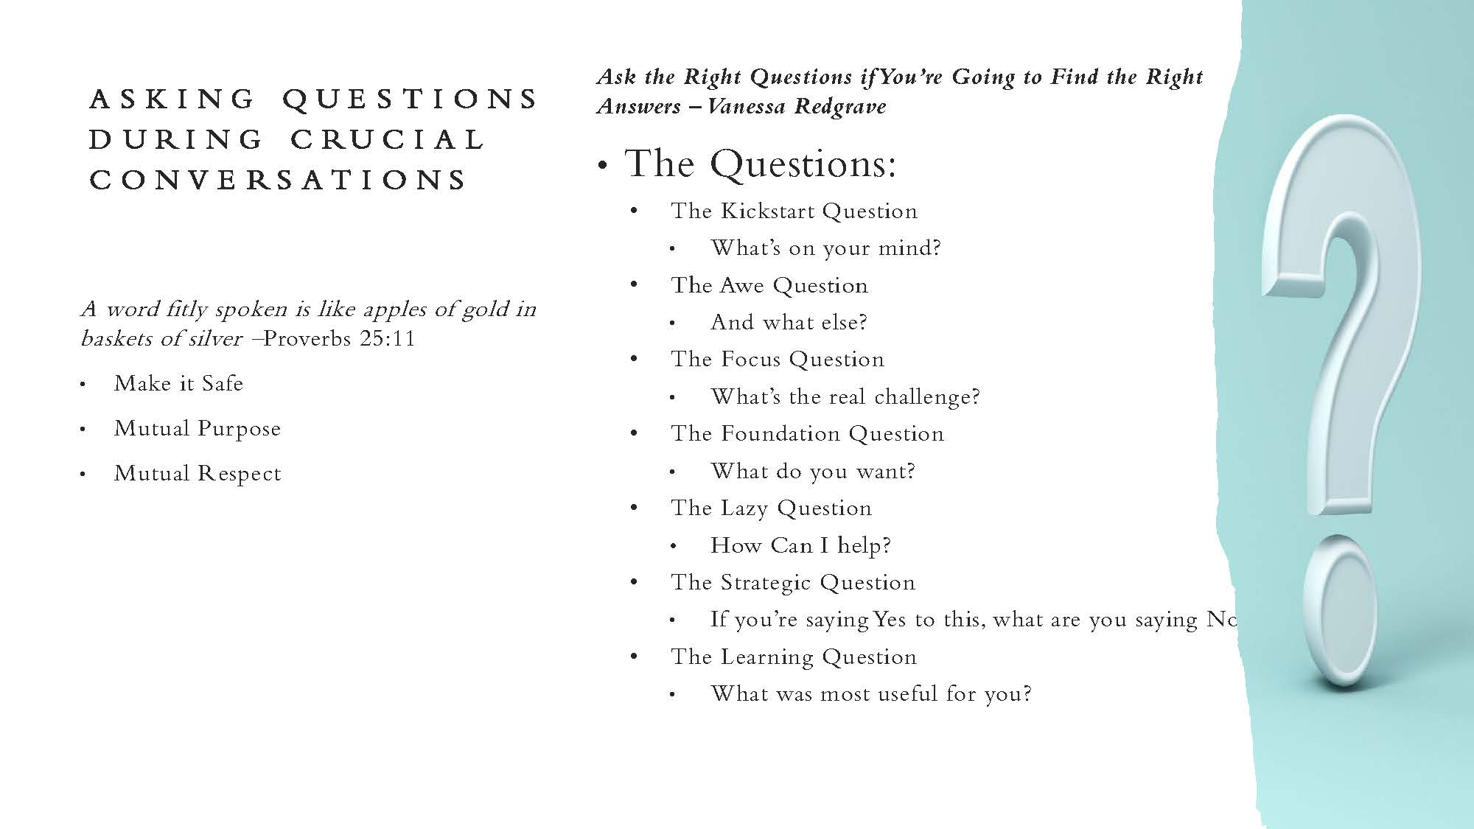

Slide 3
Appreciation
Feedback = positive and negative
Praise to criticism ratio
Be specific
Examples:
  Here’s where you’re improving…
  I see what you’re doing over here and that’s what we need.
  Personal strengths vs. team strengths
Notes:
Feedback includes both positive and negative feedback.
Praise motivates employees to do better, even employees who are already performing well. More open to receiving constructive feedback
// to Gottman’s research on married couples
Praise leads to more motivated employees and is a way of saying “I see you”
Appreciation gap: 80% of managers say they express their appreciation, less than 20% of employees say they hear appreciation frequently.
Avoid feedback sandwich
In studies of performance evaluations, women are given more vague feedback than men. Avoid phrases like "nice job" but explain the why and impact.
Not just to team members, but to peers and other coworkers. Call out and lift up (in a genuine way).
Focus on me-strengths (usually already aware of) and we-strengths (less cognizant of)
Other ideas:
proactive
taken responsibility
offered good ideas
showed loyalty and commitment
promoted teamwork

Slide 4
Listening - benefits
Studies show that listening to employees talk about their own experiences first:
Makes employees more relaxed
More self-aware of their strengths and weaknesses
More willing to reflect in a non-defensive manner
More willing to cooperate
Helps employees feel psychologically safe and less defensive

Slide 5
Listening - tips
Tips for listening:
Give 100% of your attention
Do not interrupt or finish sentences or thoughts
Do not judge or evaluate
Do not impose solutions
Ask follow up questions (open ended)
Reflect what you’ve heard

Slide 6
Providing Feedback
Describe the situation of behavior you would like to address
Describe the effects of the behavior
  For steps 1-2, focus on the facts; keep the conversation subjective
  Be specific! Spell out how the behavior impacts your business unit, others within it, and (if applicable) external parties
Discuss alternatives
  Provide your desired steps, but invite participation and input from the feedback recipient
Agree on outcomes & next steps

Slide 7
Providing Feedback
The prior model can be used for positive & constructive feedback
  If positive feedback:
    Describe the positive situation or behavior
    Describe the effects of that behavior
    Encourage a continuation or expansion of that behavior
  Benefits of positive feedback:
    Reinforces positive behaviors
    Helps build morale
    Builds a reservoir of goodwill

Slide 8
References
Huston, T., Let's Talk: Make Effective Feedback Your Superpower, Random House
Patterson, K, et.al., Crucial Conversations: Tools for Talking When Stakes Are High, 2nd Edition, McGraw Hill
Stanier, M., The Coaching Habit: Say Less, Ask More & Change the Way You Lead Forever, Box of Crayons Press

