Slide 1
PURPOSE-DRIVEN LEADERSHIP
[Name]
[date]
PURPOSE
PRIORITIES
POTENTIAL
PROGRESS
Questioned + Confirmed
Clarified + Personalized
Vivid + Visualized
Connected + Illuminated
For questions + comments: peter@time4good.net
All Slides are Intellectual Property of Time4Good LLC.
Please do not redistribute without collaboration/consent

Slide 2
PURPOSE
Questioning and
Confirming Why
NAME
DATE
Your Fork
Your Horizons
Your Inner Engine
a) Why did you decide to be here? Why did you choose to be at this particular fork in the road?
Join Macquarie, and more generally
b) Why do you think you’re a good person to be here? What attributes have you brought to this fork?
Why you got in / were picked / generally good to have around
a) Why are you excited about where you could be in 5-10 years?
b) If you knew you only had a few months left here / on this, what would you ensure gets done & why?
a) When are you in flow? What activities cause you to forget eat + drink? and if you can, describe why
i) at work ii) at play iii) back in childhood
b) Why are you here? …for “your one wild and precious life” (Mary Oliver)
1
2
3
My Impact…
e.g. I believe in
I want to bring X to do/create Y

Slide 3
PRIORITIES
Clarifying and
Personalizing ‘Rocks’
NAME
DATE
For each rock fill in your personalized adjective(s) / verb (s)

Slide 4
POTENTIAL
Vivid Visualization
of Success by _________________
[12+ months out]
NAME
DATE
Draft in the Past Tense – “Toastable” Sentence(s) you want to be true / have happened by the date at the top
Think both Concrete / Quantitative (e.g., numbers) and Vivid / Qualitative (‘champagne moments’)

Slide 5
PROGRESS
Connected & Illuminated
Life On One Page
NAME
Purpose :
Priority Area (‘Rock’) | Defined Success by [Date eg 12+months out / significant milestone date across ‘rocks’] | Priority Tasks next [eg 7/30/60/90 days] To [Date] | Progress as of [today’s date] (Status + Rating eg 1-4)
[Rock] | [Potential] | [the bridge – suggest this column completed last] | [current status]
4
3
2
1

Slide 6
Appendix
Extra resources:
The ‘Rocks’ visual
A Progress Update to a third party – formatted to externalize PPPP thinking without the course and ‘Rock’ analogy
A Purpose-Driven Day – configure to help you on a daily basis (move cross hairs to accommodate the amount of daily notes/tasks you write down per ‘Rock’ )
PURPOSE
PRIORITIES
POTENTIAL
PROGRESS
Questioned + Confirmed
Clarified + Personalized
Visualized + Vivid
Connected + Illuminated
For questions + comments: peter@time4good.net
All Slides are Intellectual Property of Time4Good LLC.
Please do not redistribute without collaboration/consent

Slide 7
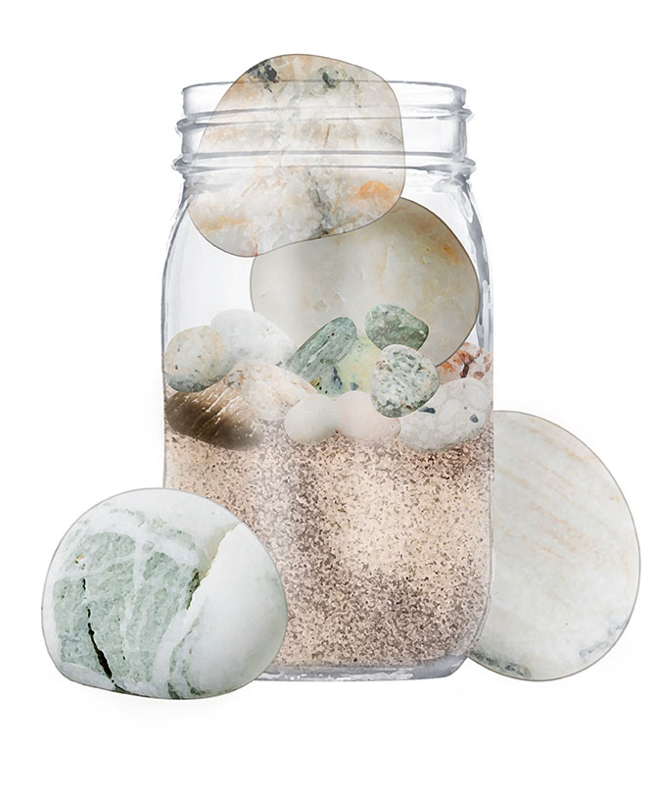
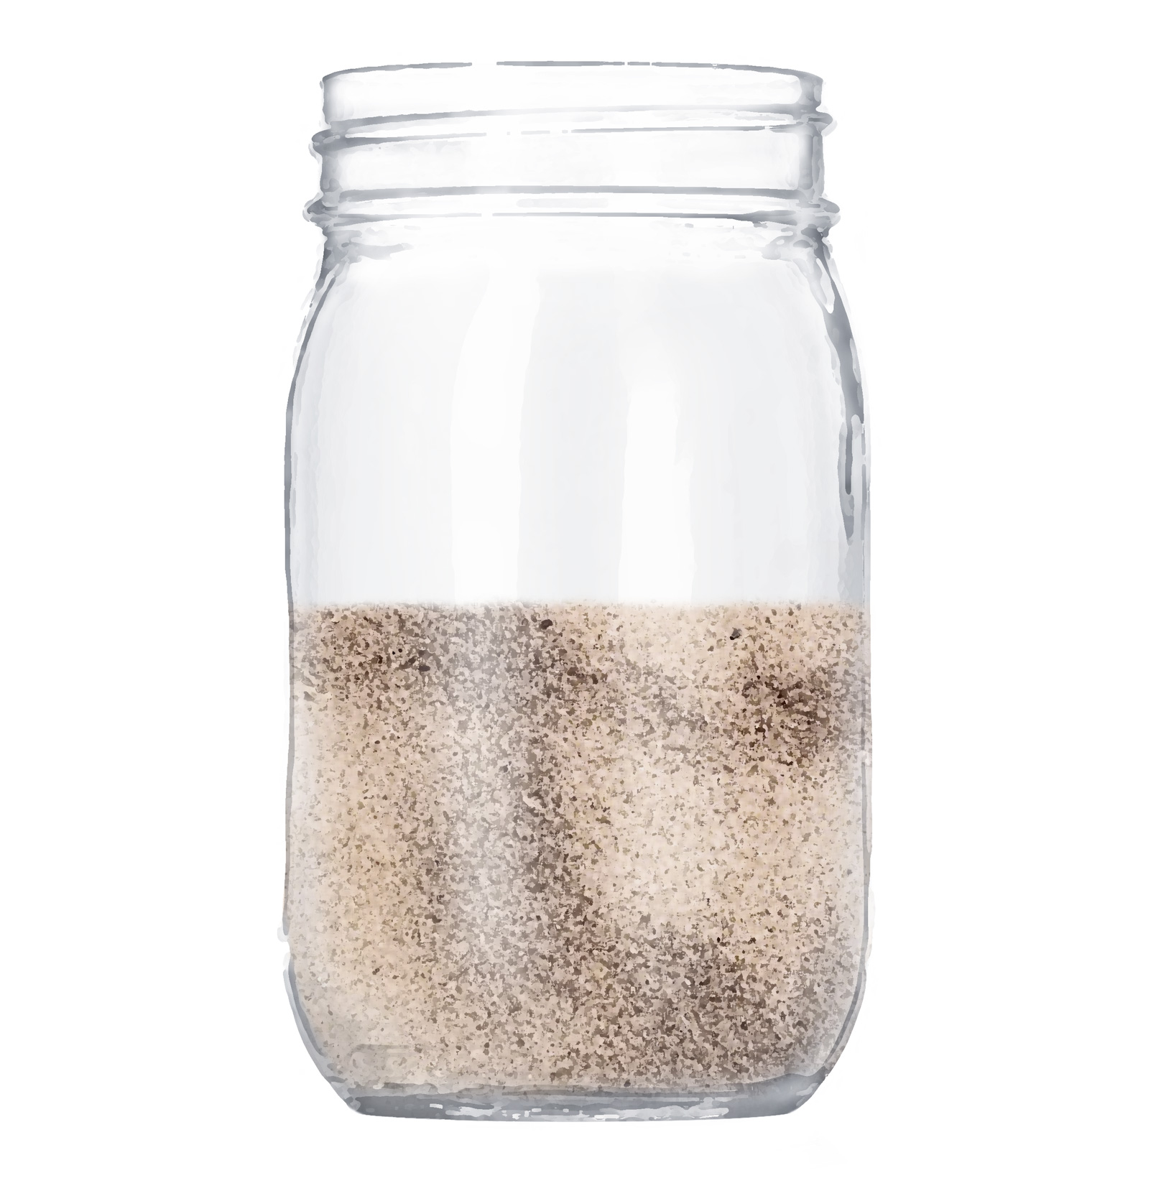
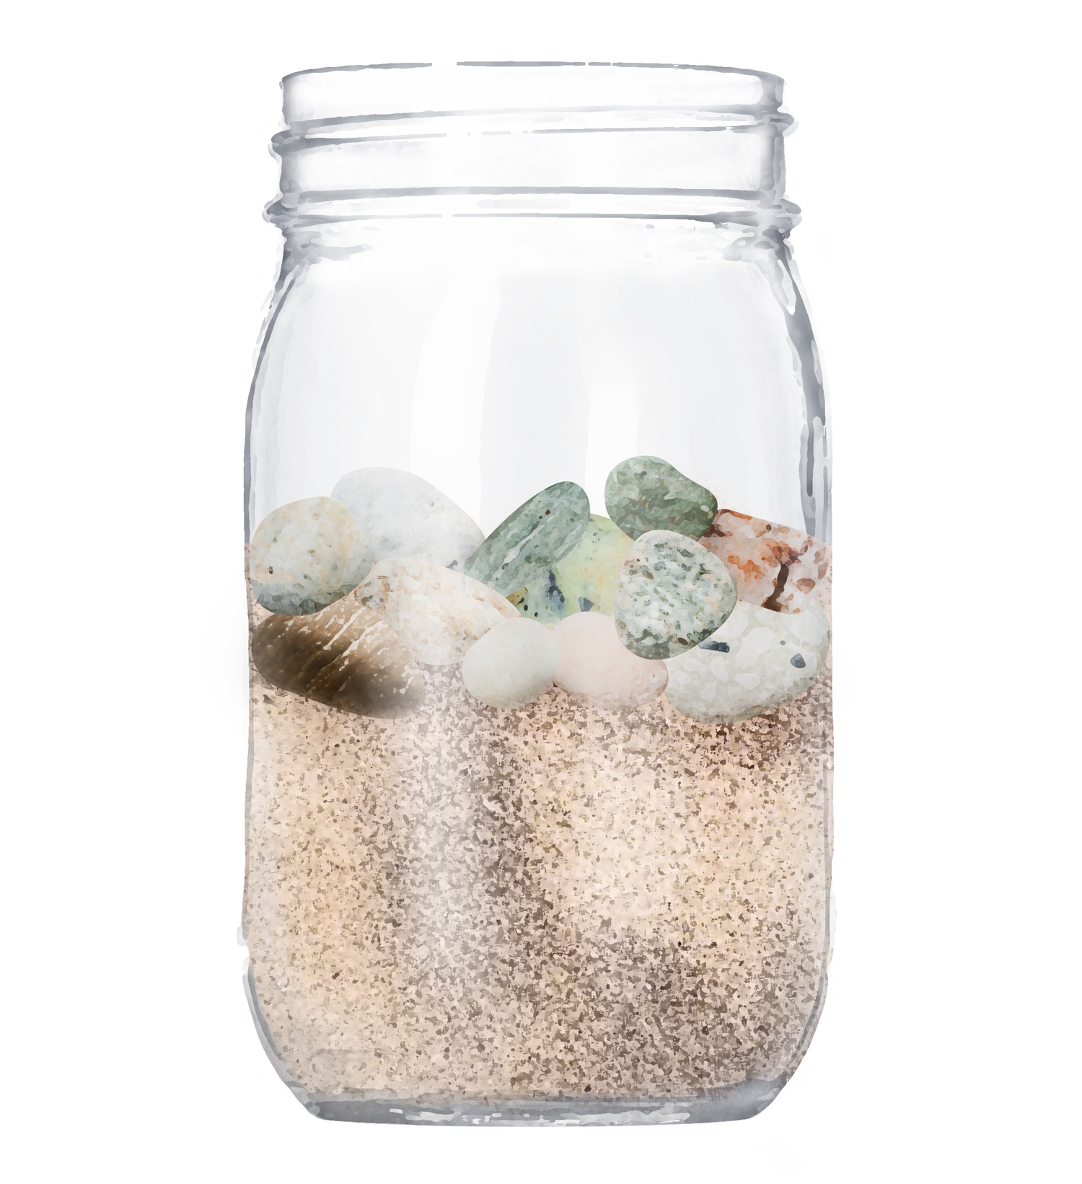
PRIORITIES
A Powerful
Mental Model

Slide 8
PROGRESS UPDATE
Connected & Illuminated
Life/Work/Project on one page
NAME
DATE
Key Priority Area | Progress Since [eg Date of Last Meeting] | Priorities To [Date]
[Rock] | [text] | [text]
A modified version of this page could serve as progress review with mentor/coach/peer-coach/client

Slide 9
PURPOSE
dd/mm
day
A Purpose-Driven Day
Vision:
Mission:
Today:
PRIORITIES +
POTENTIAL
PROGRESS
‘Rocks’
By end of day…
Time inventory + wins; Gratitude and Sparks
ROCK
ROCK
[slide the lines to accommodate your ’Rocks’ according to how much space each needs on a daily sheet – need not be equal]
ROCK
ROCK
Record time as used & rating of how time spent (eg Rate 1-4; 4 great move of rock; 1 is ‘sand’)
Wins? (eg with Asterisk to refer back to?)
3-5 max key wins for the day (double squares?)
and other tasks to win the day (single square?).
Include carry-overs from previous days (e.g. as ovals?)
Identify Tasks that you need to remember but are a distraction for today
Black or Blue ink @ start of day, the other as day progresses
Red – New to be aware; Green – victories, ‘done’, insights, gratitude

