Slide 1
December 10th 2021
INSPIRED, PURPOSE-DRIVEN TEAMS
Pre-Work for Workshop5
InspireCorps | Jen Grace Baron, Peter Boyd, Gabi Joyce, Katie Giasullo

Slide 2
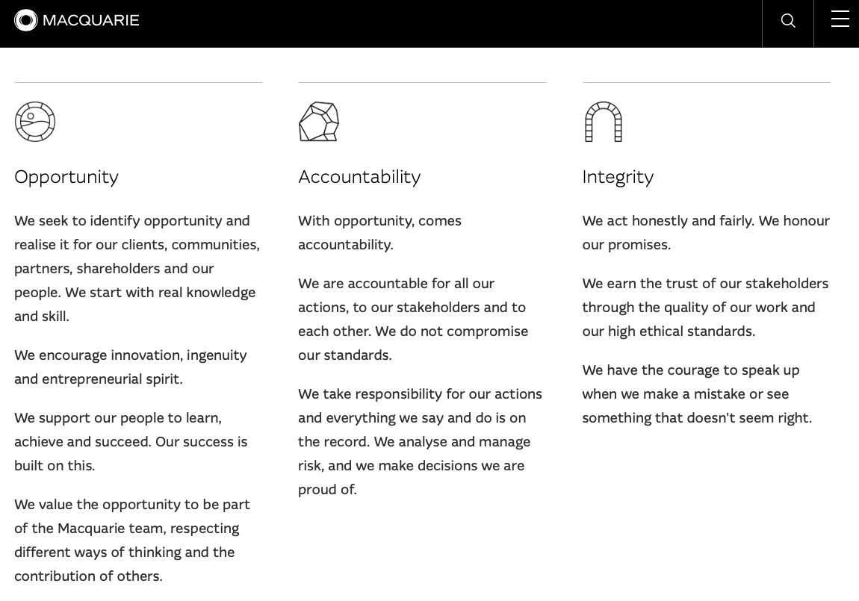
PURPOSE MAPPING
Connecting my Why with Firm Why:
Team Mission
NAME
DATE
Macquarie
Purpose and Principles
My Purpose
& Values
Team Purpose
& Values
Our Purpose
Empowering people to innovate and invest for a better future.
Our Principles
Notes:
eg “Ship flawless, useful code to power a net-zero energy future at the speed the company and planet needs”

Slide 3
Max Landsberg* The Tao of Coaching, 1996 [Derived from Hersey & Blanchard, 1977] Skill Will Matrix
TEAM & CONTRACTORS
Skill
Skill
Concept
Action
3. Able but unwilling / insecure
4. Able and willing / confident
1. Unable and unwilling / insecure
2. Unable but willing / confident
Encourage
Empower
Move
Train
Will
Will
* The first McKinsey partner to interview me in London office when I graduated!

Slide 4
TEAM SKILL-WILL MATRIX
Skill
 |  |  | [name]
[name]
[Please feel free to use the text table or create individual shapes for names and move them around free-hand]
[name]
Will

Slide 5
TEAM SKILL-WILL MATRIX-AS-TABLE
Name | Action Quadrant / Score | Notes | Action Plan

Slide 6
Jeston & Nalis Built from Various similar matrices – eg stakeholdermap.com/stakeholder-matrix.html
STAKEHOLDERS
Influence
Influence
Concept
Action
Influential Blocks
Influential Champions
Less-consequential Nay-sayers
Fans
Strategy 2 Manage Each?
Jobs 2 Do?
Worry 2 Much?
2 Way Communication?
Support
Support
Support
Notes:
Sphere of influence…
https://www.stakeholdermap.com/stakeholder-matrix.html

Slide 7
STAKEHOLDER MATRIX
Influence
 |  |  | [name]
[name]
[Please feel free to use the text table or create individual shapes for stakeholders and move them around free-hand]
[name]
Support

Slide 8
STAKEHOLDER MATRIX-AS-TABLE
Stakeholder | Quadrant / Score | Notes | Action Plan

