Slide 1
January 2022
INSPIRED, PURPOSE-DRIVEN TEAMS
Pre-Work for Workshop 6
InspireCorps | Jen Grace Baron, Peter Boyd, Gabi Joyce, Katie Giasullo

Slide 2
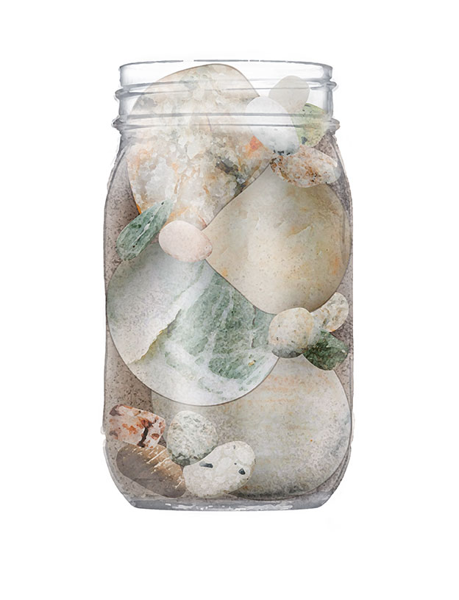
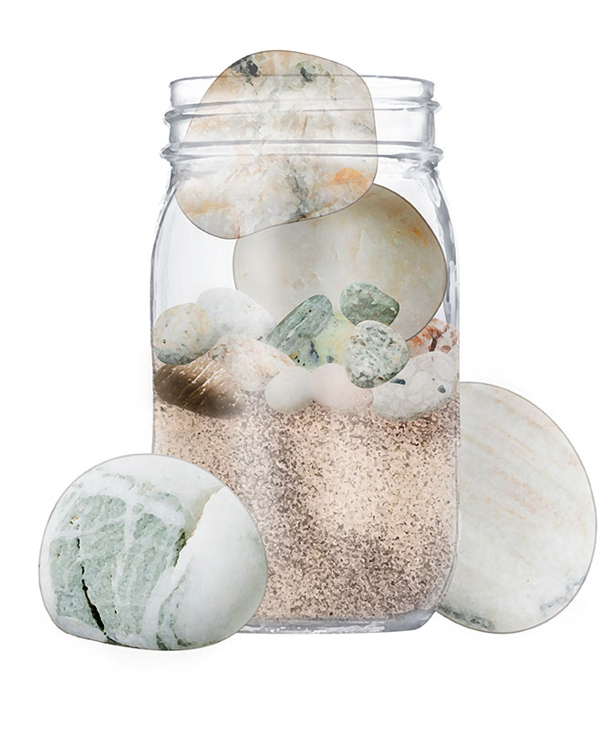
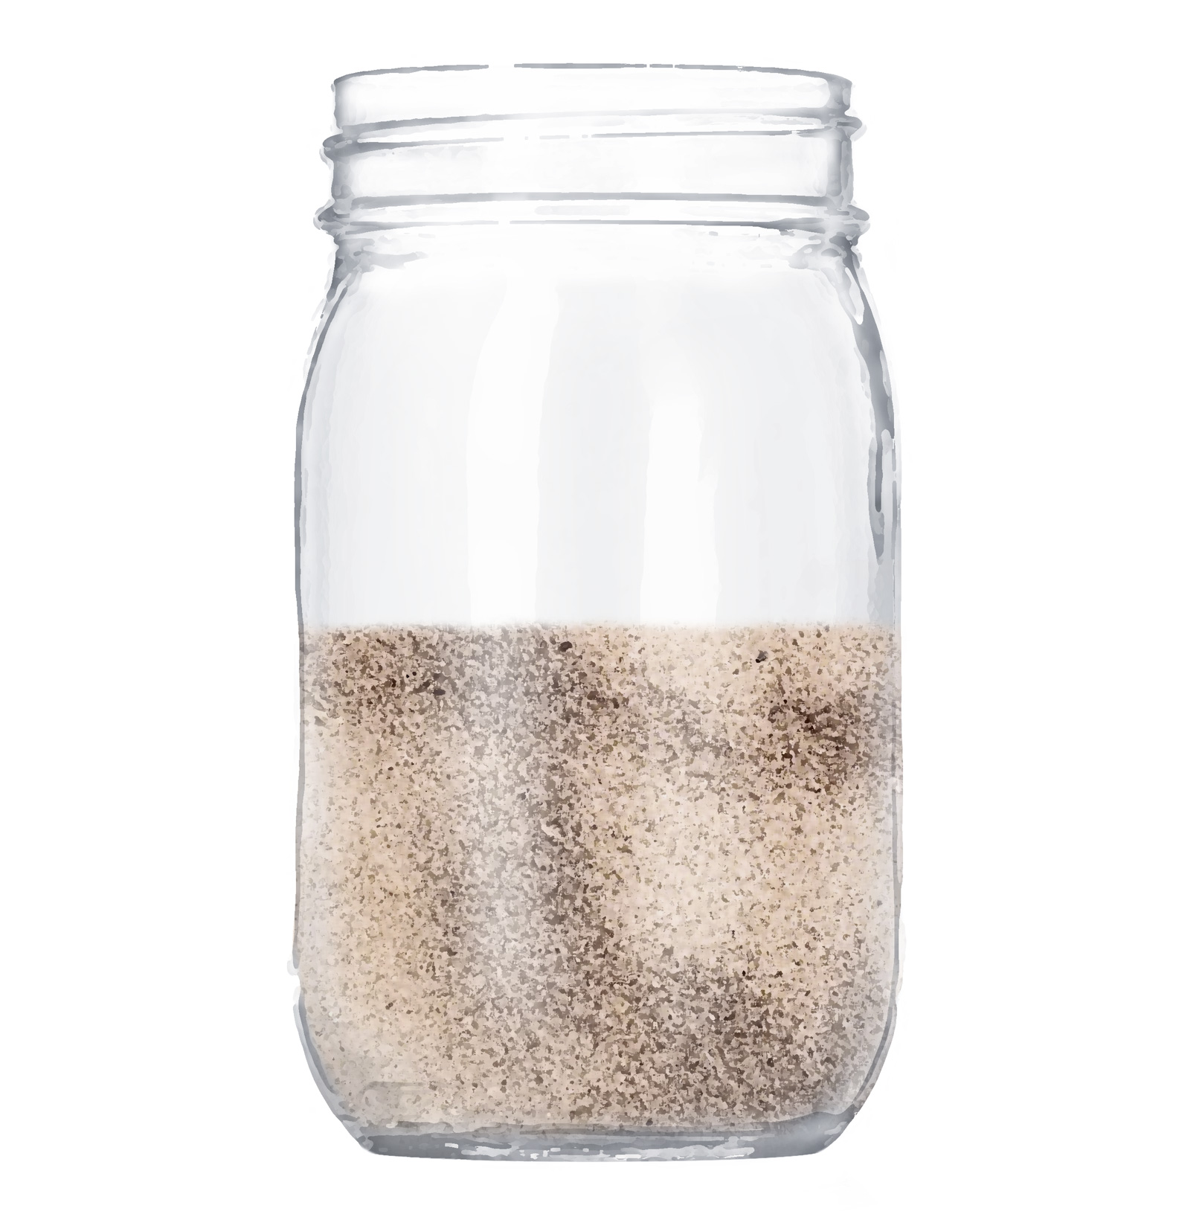
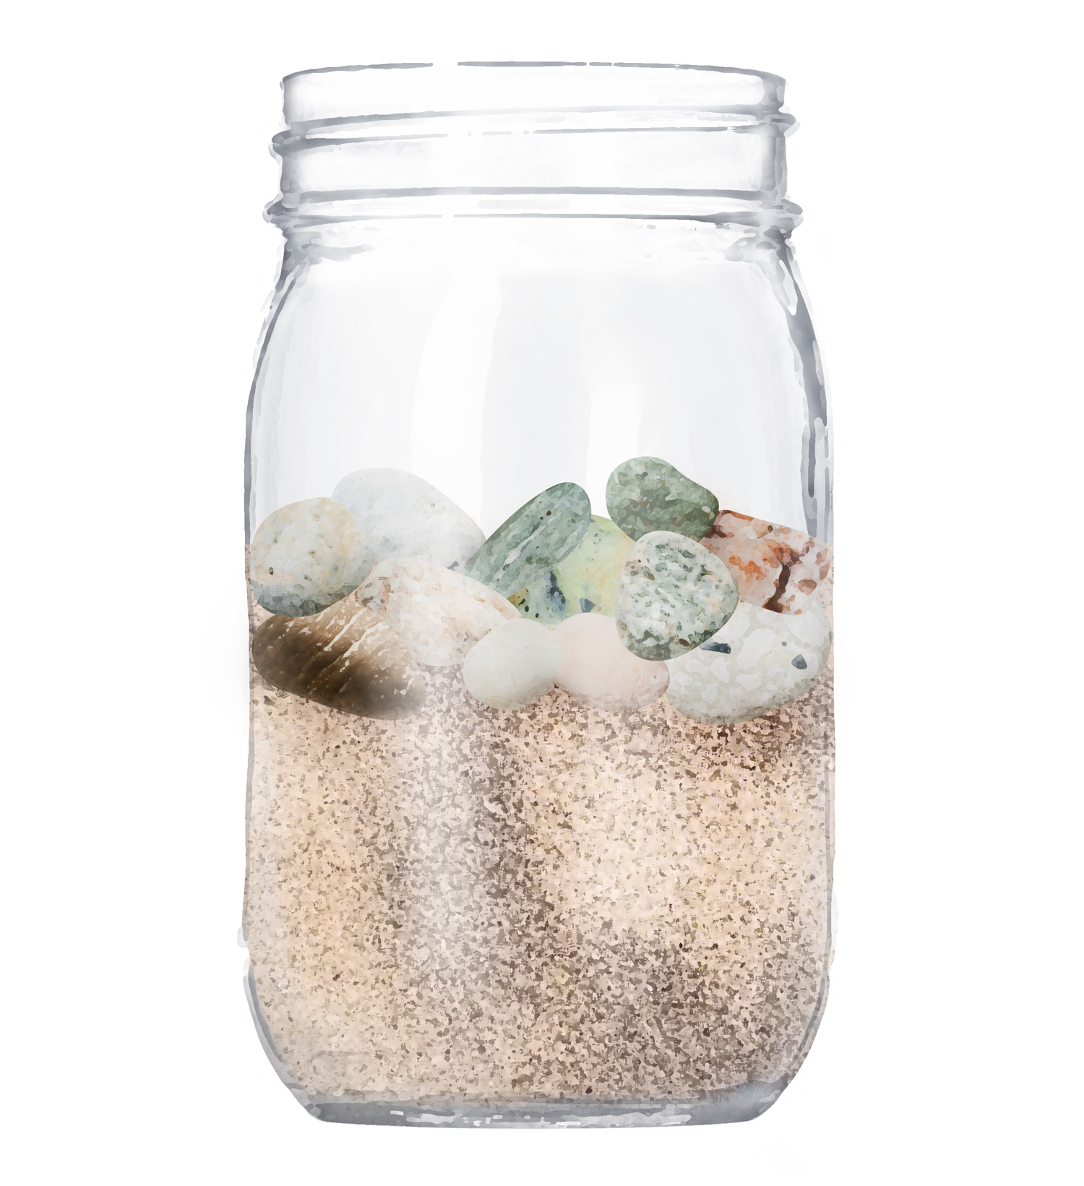
PRIORITIES – PRE-WORK FOR ALL

Slide 3
[Name] – MCT On One Page
DATE
Priority Area
(‘Rock’)
Defined Success by December 31st 2022
Priorities
to [eg date 7-30-90 days out as required]
Progress (Rating + status)
as of [date today]
[Rock]
[Potential]
[the bridge]
[current status]

Slide 4
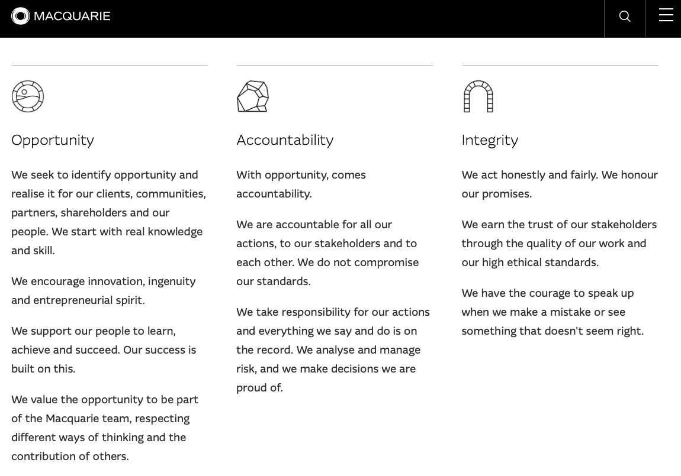
PURPOSE MAPPING
Connecting my Why with Firm Why:
Team Mission
NAME
DATE
Macquarie
Purpose and Principles
My Purpose
& Values
Team Purpose
& Values
Our Purpose
Empowering people to innovate and invest for a better future.
Psychological Safety
Clear Communication
Decide – Balancing Empowerment & Consensus
FIRE – Fun, Integrity, Respect, Attitude
Our Principles
Dan MacP
Peter T
+?
Notes:
eg “Ship flawless, useful code to power a net-zero energy future at the speed the company and planet needs”

Slide 5
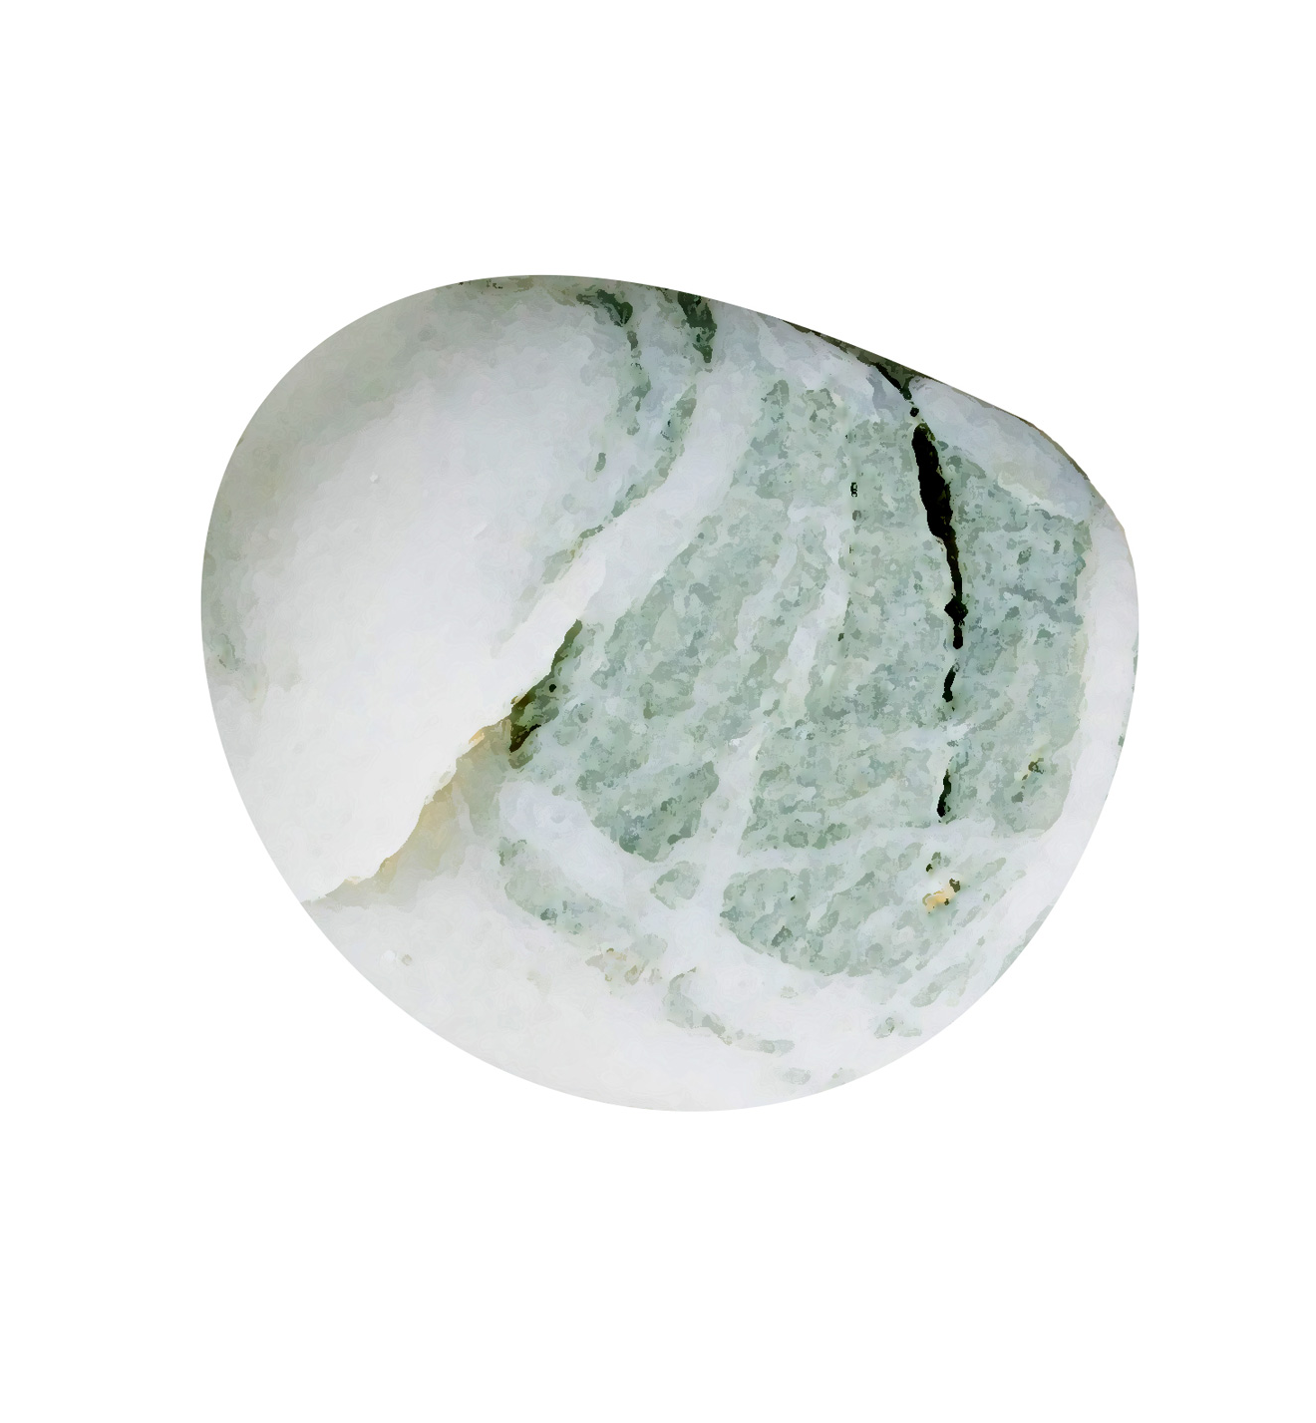
PRIORITIES - TEAM
Clarifying and
Personalizing ‘Rocks’
NAME
DATE
Team Purpose :
Aarnoud
Jenn
+?
Team Priorities / ‘Rocks’
DH Priorities / ‘Rocks’
[DR1] ‘Rocks’
[DR2] ‘Rocks’
[DR3] ‘Rocks’
[DR4] ‘Rocks’
[DR5] ‘Rocks’

Slide 6
January 2022
Appendix – Still Useful from Session5
InspireCorps | Jen Grace Baron, Peter Boyd, Gabi Joyce, Katie Giasullo

Slide 7
PURPOSE MAPPING
Connecting my Why with Firm Why:
Team Mission
NAME
DATE
Macquarie
Purpose and Principles
My Purpose
& Values
Team Purpose
& Values
Our Purpose
Empowering people to innovate and invest for a better future.
Our Principles
Notes:
eg “Ship flawless, useful code to power a net-zero energy future at the speed the company and planet needs”

Slide 8
Max Landsberg* The Tao of Coaching, 1996 [Derived from Hersey & Blanchard, 1977] Skill Will Matrix
TEAM & CONTRACTORS
Skill
Skill
Concept
Action
3. Able but unwilling / insecure
4. Able and willing / confident
1. Unable and unwilling / insecure
2. Unable but willing / confident
Encourage
Empower
Move
Train
Will
Will
* The first McKinsey partner to interview me in London office when I graduated!

Slide 9
TEAM SKILL-WILL MATRIX
Skill
 |  |  | [name]
[name]
[Please feel free to use the text table or create individual shapes for names and move them around free-hand]
[name]
Will

Slide 10
TEAM SKILL-WILL MATRIX-AS-TABLE
Name | Action Quadrant / Score | Notes | Action Plan

Slide 11
Jeston & Nalis Built from Various similar matrices – eg stakeholdermap.com/stakeholder-matrix.html
STAKEHOLDERS
Influence
Influence
Concept
Action
Influential Blocks
Influential Champions
Less-consequential Nay-sayers
Fans
Strategy 2 Manage Each?
Jobs 2 Do?
Worry 2 Much?
2 Way Communication?
Support
Support
Support
Notes:
Sphere of influence…
https://www.stakeholdermap.com/stakeholder-matrix.html

Slide 12
STAKEHOLDER MATRIX
Influence
 |  |  | [name]
[name]
[Please feel free to use the text table or create individual shapes for stakeholders and move them around free-hand]
[name]
Support

Slide 13
STAKEHOLDER MATRIX-AS-TABLE
Stakeholder | Quadrant / Score | Notes | Action Plan

